Slide 1


UNIT 7: On top of the world
A class of
their own

Slide 2
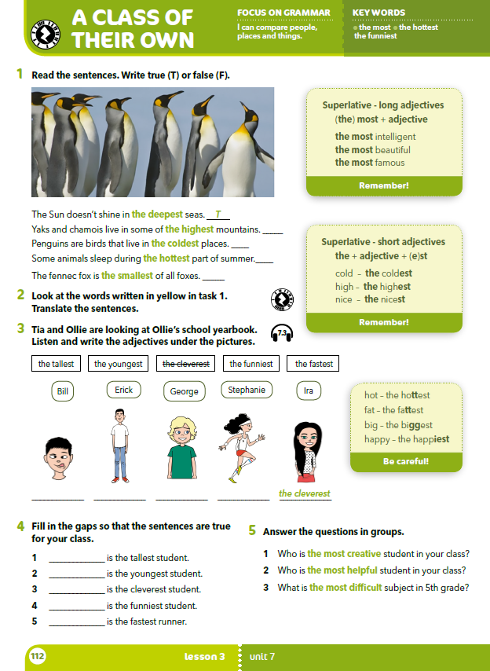
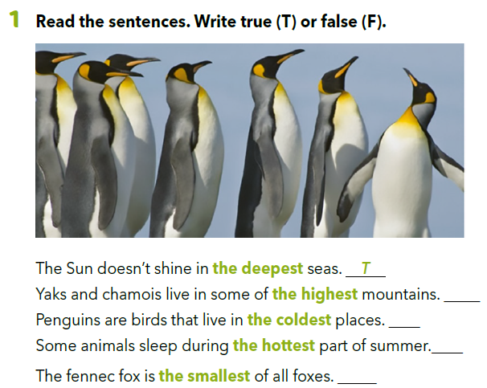
T
T
T
T

Slide 3
How do the words in green end?
They end in –est.
What is there before the adjectives?
The article ”the”.
najdublja mora
najviše planine
najhladnija mjesta
najtopliji dijelovi ljeta
najmanja od svih lisica
This form of adjectives is called the superlative.

Slide 4
How do we form the superlatives of short adjectives?
the + adjective + -(e)st
high →
cold →
nice →
happy →
big →
fat →
the + high + -est = the highest visok → najviši
the + cold + -est = the coldest hladan → najhladniji
the nice + -st = the nicest drag → najdraži
the happ + i + -est = the happiest sretan → najsretniji
the big + g + est = the biggest velik → najveći
the fat + t + est = the fattest debeo → najdeblji

Slide 5
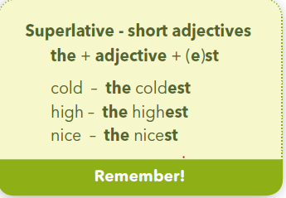
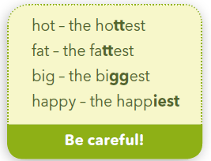

Slide 6
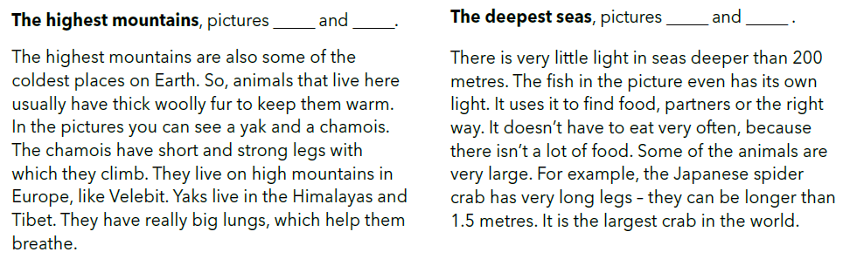
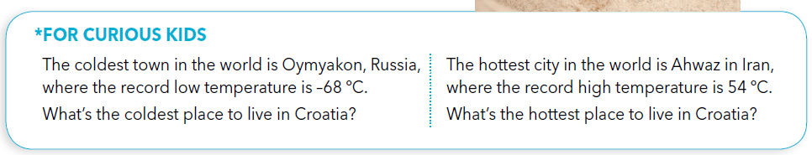
Underline the superlatives at pages 110 and 111.

Slide 7
How are the superlatives similar to comparatives?
We add the suffix to the adjective.
U oba slučaja dodajemo pridjevu dodajemo nastavak.
What is different?
We add the article ”the” in front of the superlatives.
Prije superlativa pišemo član „the”.

Slide 8
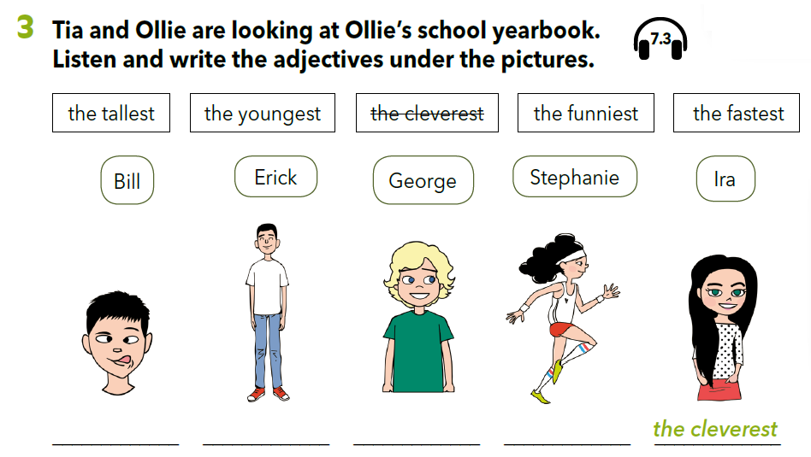
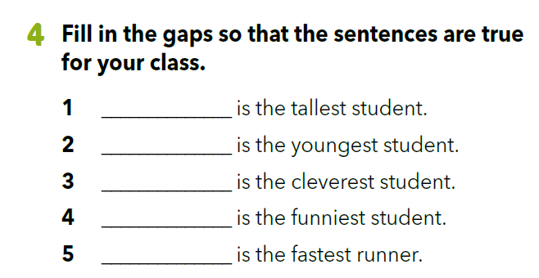

https://www.e-sfera.hr/dodatni-digitalni-sadrzaji/4927907c-778e-4ec0-a0ca-1578d8718b20/assets/audio/54_ollie_yearbook.mp3
the funniest
the tallest
the youngest
the fastest

Slide 9
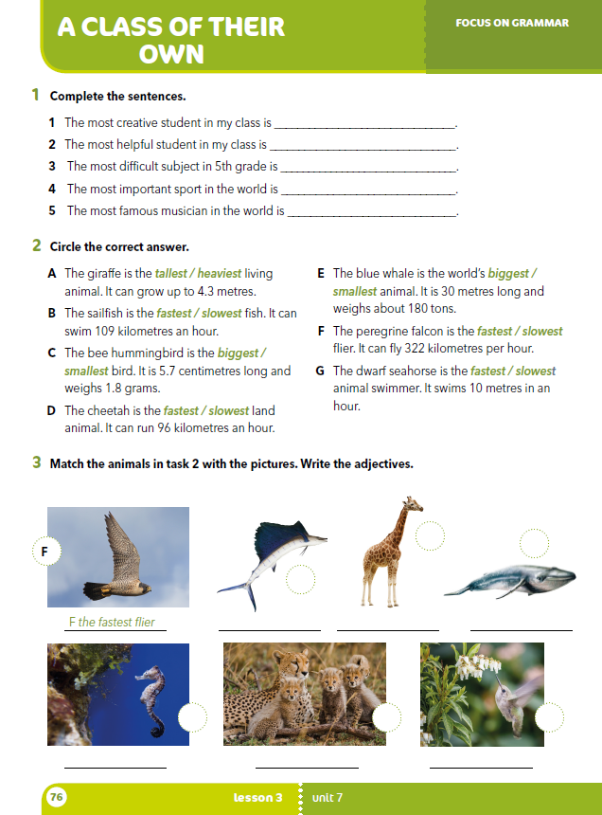
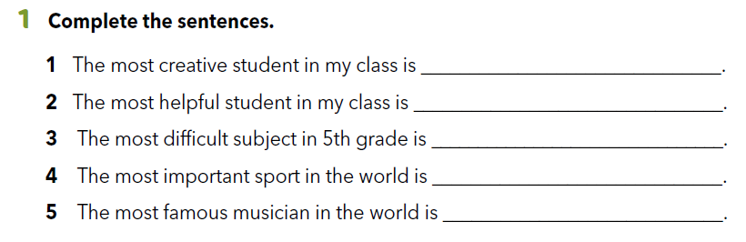
Workbook p. 76
SELF CHECK.
https://www.e-sfera.hr/dodatni-digitalni-sadrzaji/4927907c-778e-4ec0-a0ca-1578d8718b20/

Slide 10
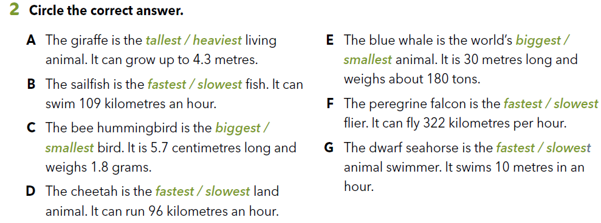
Workbook p. 76

Slide 11
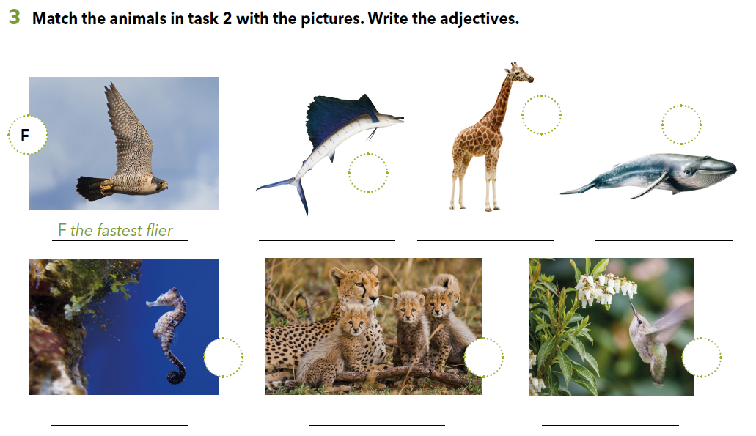
A
E
B
the fastest fish
the tallest animal
the world’s biggest animal
G
D
A
the slowest swimmer
the fastest land animal
the smallest bird

Slide 12

LEARN MORE
https://www.e-sfera.hr/dodatni-digitalni-sadrzaji/4927907c-778e-4ec0-a0ca-1578d8718b20/
Animal records

